Slide 1



Introduction to SQL
Sistem Basis Data
Rizka Wakhidatus Sholikah

Slide 2



Outline
Introduction to SQL
History of SQL
SQL command
Data type
MySQL
www.its.ac.id
INSTITUT TEKNOLOGI SEPULUH NOPEMBER, Surabaya - Indonesia

Slide 3
Introduction to SQL
SQL stands for Structured Query Language
The standard for Relational Database Management Systems (RDBMS)
RDBMS: a database management system that manages data as a collection of tables in which all relationships are represented by common values in related tables
Composed of commands that enable users to create database and table structures, perform data manipulation and data administration, and query to extract useful information
SQL is not mean to stand alone in the application area
www.its.ac.id
INSTITUT TEKNOLOGI SEPULUH NOPEMBER, Surabaya - Indonesia

Slide 4
Purpose of SQL
Specify syntax/ semantics for data definition and manipulation
Define data structures and basic operations
Enable portability of database definition and application modules (communicate between application and database)
www.its.ac.id
INSTITUT TEKNOLOGI SEPULUH NOPEMBER, Surabaya - Indonesia

Slide 5
Advantage
Faster query processing
Can retrieve large amount of data quickly and efficient
No coding skills
No need to perform coding to get the data
Standardized language
Provides a uniform platform
Long establishment
Portable
Can be used independent of any platform
Interactive language
Easy to learn and understand
www.its.ac.id
INSTITUT TEKNOLOGI SEPULUH NOPEMBER, Surabaya - Indonesia

Slide 6
Disadvantage
Complex interface
Has difficult interface that makes few users uncomfortable
Cost
Some version are costly
Partial control
Complete control is not given to the database
www.its.ac.id
INSTITUT TEKNOLOGI SEPULUH NOPEMBER, Surabaya - Indonesia

Slide 7
History of SQL
1970-E.F.Codd develops relational database concept
1974-system R with sequel created at IBM
1981-SQL first available RDBMS on DOS
1979-Oracle markets first relational DB with SQL
1986-ANSI SQL standard released
1989-2008 Major ANSI standard updates
www.its.ac.id
INSTITUT TEKNOLOGI SEPULUH NOPEMBER, Surabaya - Indonesia

Slide 8
SQL commands
DDL (Data Definition Language)
DML (Data Manipulation Language)
TCL (Transaction Control Language)
DCL (Data Control Language)
www.its.ac.id
INSTITUT TEKNOLOGI SEPULUH NOPEMBER, Surabaya - Indonesia

Slide 9
DDL
Consist of SQL commands that can be used to define the database schema
Used to create and modify the structure of database
Used to create, modify, and delete database structures but not data
These commands not used by a general user (accessing the database via application)
www.its.ac.id
INSTITUT TEKNOLOGI SEPULUH NOPEMBER, Surabaya - Indonesia

Slide 10
DDL
List of DDL commands:
CREATE
Uses to create database or its objects (ex: table)
DROP
Uses to delete object from the database
ALTER
Uses to alter the structure of the database
TRUNCATE
Uses to remove all record from the table
COMMENT
Uses to add comment to data dictionary
RENAME
Uses to rename an object in the database
www.its.ac.id
INSTITUT TEKNOLOGI SEPULUH NOPEMBER, Surabaya - Indonesia

Slide 11
DML
Deals with the manipulation of data present in the database
List of DML commands:
INSERT
Insert data into table
UPDATE
Update existing data within a table
DELETE
Delete records from a database table
www.its.ac.id
INSTITUT TEKNOLOGI SEPULUH NOPEMBER, Surabaya - Indonesia

Slide 12
DCL
Control access to data and to database, such as giving permission to certain user
List of DCL commands:
GRANT
Command to gives user privileges to the database
REVOKE
Command to withdraw access privilege
www.its.ac.id
INSTITUT TEKNOLOGI SEPULUH NOPEMBER, Surabaya - Indonesia

Slide 13
TCL
Deal with the transaction within the database
Transactions group a set of tasks into a single execution unit
List of TCL commands:
COMMIT
Saves all the transactions to the database since the last COMMIT
ROLLBACK
If any error occurs with any of the SQL grouped statements, all changes need to be aborted
The reversing changes is called ROLLBACK
SAVEPOINT
Creates points within the groups of transactions in which to ROLLBACK
www.its.ac.id
INSTITUT TEKNOLOGI SEPULUH NOPEMBER, Surabaya - Indonesia

Slide 14
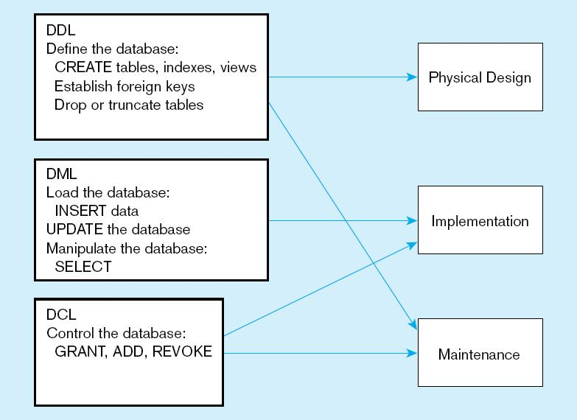
www.its.ac.id
INSTITUT TEKNOLOGI SEPULUH NOPEMBER, Surabaya - Indonesia

Slide 15
Data types
A data type is a specification about the kinds of data that can be stored in an attribute
Data types influence the queries that retrieve data because there are slight differences in the syntax of SQL and how it behaves
Three fundamental types of data:
Character data → any printable character data, such as alphabetic values, digits, punctuation, and special character
Example: String
Numeric data → composed of digits, such that the data has a specific numeric values
Example: Int
Date data → composed of date and time values
www.its.ac.id
INSTITUT TEKNOLOGI SEPULUH NOPEMBER, Surabaya - Indonesia

Slide 16
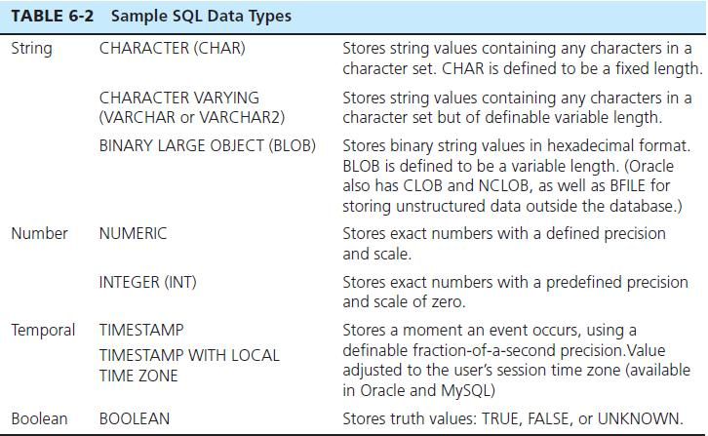
Data types
www.its.ac.id
INSTITUT TEKNOLOGI SEPULUH NOPEMBER, Surabaya - Indonesia

Slide 17
Introduction to MySQL
MySQL is a fast, easy-to-use RDBMS
Use for many small and big businesses
Why MySQL so popular:
MySQL release under an open source license
Very powerful program
A standard form of the well-known SQL data language
Works on many operating system
Works well even with large data set
www.its.ac.id
INSTITUT TEKNOLOGI SEPULUH NOPEMBER, Surabaya - Indonesia

Slide 18
MySQL
Install MySQL or XAMPP (windows user) or LAMPP (linux user)
www.its.ac.id
INSTITUT TEKNOLOGI SEPULUH NOPEMBER, Surabaya - Indonesia

Slide 19
MySQL
Create database
Syntax
CREATE DATABASE databasename;
www.its.ac.id
INSTITUT TEKNOLOGI SEPULUH NOPEMBER, Surabaya - Indonesia

Slide 20
MySQL
Create table
Syntax
CREATE TABLE table_name ( attribute1 datatype, attribute2 datatype, attribute3 datatype, ....
PRIMARY KEY (attribute PK) );
www.its.ac.id
INSTITUT TEKNOLOGI SEPULUH NOPEMBER, Surabaya - Indonesia

Slide 21
MySQL
Create primary key when the table already exist
Syntax
CREATE TABLE table_name ( attribute1 datatype, attribute2 datatype, attribute3 datatype, .... );
ALTER TABLE table_name
ADD PRIMARY KEY (attribute PK);
www.its.ac.id
INSTITUT TEKNOLOGI SEPULUH NOPEMBER, Surabaya - Indonesia

Slide 22
MySQL
Create foreign key when the table already exist
Syntax
CREATE TABLE table_name ( attribute1 datatype, attribute2 datatype, attribute3 datatype, .... );
ALTER TABLE table_name
ADD FOREIGN KEY (attribute FK)
REFERENCES table_name(attribute PK);
www.its.ac.id
INSTITUT TEKNOLOGI SEPULUH NOPEMBER, Surabaya - Indonesia

Slide 23
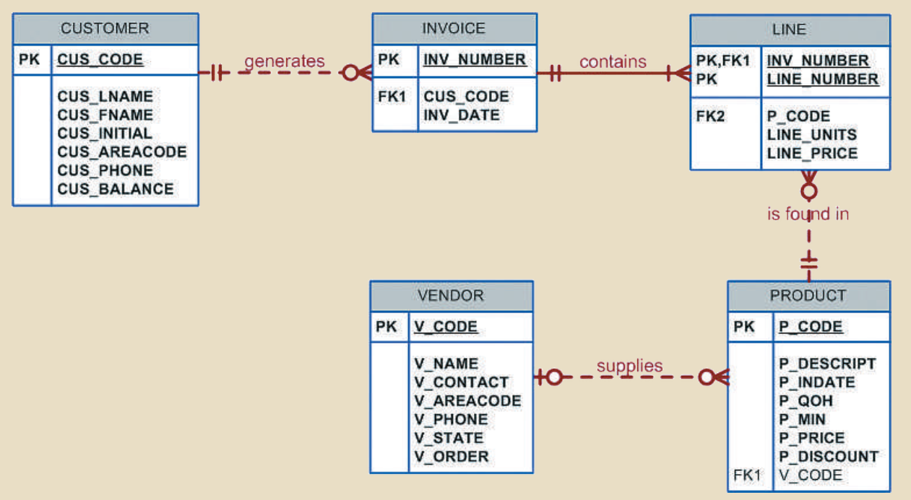
MySQL
Install MySQL or XAMPP (windows user) or LAMPP (linux user)
www.its.ac.id
INSTITUT TEKNOLOGI SEPULUH NOPEMBER, Surabaya - Indonesia

Slide 24
Thank you

